Slide 1
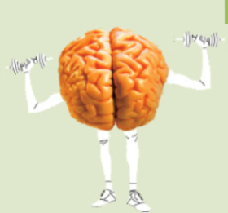

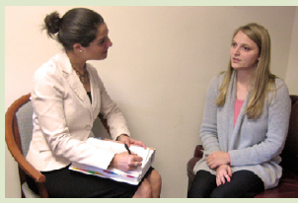
IMPACT: Imaging, Psychopathology, Cognition and Therapeutics
Home | Studies | People | Facilities | Publications | Links | Participate | Contact Us | Directions
About the Program:
The Imaging , Psychopathology, Cognition and Therapeutics (IMPACT Program) is engaged in a broad program of studies of the brain mechanisms underlying disorders of cognition and mood in healthy individuals and in those with psychiatric and medical disorders. The IMPACT Program also seeks to develop and evaluate new treatments for people with disorders of cognition and mood.
In the setting of our research programs and laboratories, our program provides a range of research training opportunities for psychiatric residents, post-doctoral fellows, medical students and graduate students. Our research and research training programs are supported through grants and endowments from the Federal Government, the Commonwealth of Massachusetts, Harvard Medical School, Beth Israel Deaconess Medical Center, and research foundations, as well as through the generous contributions of individual donors. We hope that this website will provide a useful guide for interested students, research collaborators and clinical colleagues.
Notes:
Home Page

Slide 2

IMPACT: Imaging, Psychopathology, Cognition and Therapeutics
Home | Studies | People | Facilities | Publications | Links | Participate | Contact Us | Directions
About the Program:
The Imaging , Psychopathology, Cognition and Therapeutics (IMPACT Program) is engaged in a broad program of studies of the brain mechanisms underlying disorders of cognition and mood in healthy individuals and in those with psychiatric and medical disorders. The IMPACT Program also seeks to develop and evaluate new treatments for people with disorders of cognition and mood.
In the setting of our research Programs and laboratories, our program provides a range of research training opportunities for psychiatric residents, post-doctoral fellows, medical students and graduate students. Our research and research training programs are supported through grants and endowments from the Federal Government, the Commonwealth of Massachusetts, Harvard Medical School, Beth Israel Deaconess Medical Center, and research foundations, as well as through the generous contributions of individual donors. We hope that this web site will provide a useful guide for interested students, research collaborators and clinical colleagues.
Notes:
Studies Page: Click on Studies to receive a drop-down menu to click on a specific study

Slide 3
IMPACT: Imaging, Psychopathology, Cognition and Therapeutics
Home | Studies | People | Facilities | Publications | Links | Participate | Contact Us | Directions
B-SNIP
CLUES
Studies
BICEPS
PARDIP
Sleep
Diabetes
Notes:
Click on buttons above to get to page about studies

Slide 4

IMPACT: Imaging, Psychopathology, Cognition and Therapeutics
Home | Studies | People | Facilities | Publications | Links | Participate | Contact Us | Directions
B-SNIP Study:
B-SNIP is a large-scale study, funded in 2007 by the National Institute of Mental Health. Schizophrenia and bipolar disorder both “run in families” although how they are inherited and which genes and environmental factors are the most relevant are not well understood. Neither is it clear how these factors affect brain structure and function, personality or cognitive abilities.
The purpose of the B-SNIP study is to discover how the risk for schizophrenia and bipolar disorder is transmitted in families, to identify the most important risk genes and to measure the other factors listed above.
Because the study is interested in measuring risk for the illnesses, we are as interested in assessing close family members as we are in examining people with the actual disorder.
In order to do this, several thousand people will be recruited at six sites throughout the United States, in Hartford/New Haven, CT, Athens, GA, Chicago, IL, Dallas, TX and Boston, MA. The study will assess people with schizophrenia, schizo-affective disorder, or bipolar (manic-depressive) illness on a variety of biological and genetic measures that seem to be associated with risk for the disorder.
Contact: Brandon Hager
Notes:
B-Snip Study

Slide 5
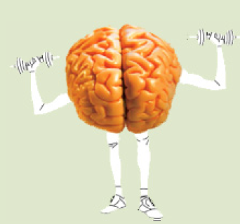
IMPACT: Imaging, Psychopathology, Cognition and Therapeutics
Home | Studies | People | Facilities | Publications | Links | Participate | Contact Us | Directions
BICEPS Study:
Brain Imaging and Cognitive Enhancement in Early Phase of Schizophrenia (BICEPS) is a study funded in 2012 by the National Institute of Mental Health.
The purpose of the BICEPS study is to understand how psychotherapy treatments work in people with early phase of schizophrenia using state-of the art and safe brain imaging studies.
In order to do this, people recently diagnosed with schizophrenia or schizoaffective disorder will be recruited at two sites, in Boston, MA and Pittsburgh, PA. These persons will receive either Cognitive Enhancement Therapy (CET) or Enriched Supportive Therapy (EST) for a period of 18 months and will be followed up to examine the effectiveness and brain mechanisms underlying these treatments.
Contact: Luis Sandoval PhD
Notes:
BICEPS Study

Slide 6
IMPACT: Imaging, Psychopathology, Cognition and Therapeutics
Home | Studies | People | Facilities | Publications | Links | Participate | Contact Us | Directions
Sleep Study:
Notes:
Sleep Study

Slide 7

IMPACT: Imaging, Psychopathology, Cognition and Therapeutics
Home | Studies | People | Facilities | Publications | Links | Participate | Contact Us | Directions
CLUES Program:
“CLUES” stand for: Cognition for Learning and for Understand Everyday Social Situations.
CLUES is designed to help improve attention, thinking, memory, and social skills in young people ages 16-30, who are being treated at the CEDAR clinic.
CLUES is based on a program called Cognitive Enhancement Therapy, which was found to help people with certain psychiatric conditions and significantly improve their thinking, work, and social functioning.
CLUES is individually tailored to focus on helping participants to identify and achieve specific goals that are important to them.
Contact: Michelle Friedman-Yakoobian PhD
Notes:
CLUES Program

Slide 8
IMPACT: Imaging, Psychopathology, Cognition and Therapeutics
Home | Studies | People | Facilities | Publications | Links | Participate | Contact Us | Directions
PARDIP Study:
Contact: Michelle Friedman-Yakoobian PhD
Notes:
PARDIP Study

Slide 9
IMPACT: Imaging, Psychopathology, Cognition and Therapeutics
Home | Studies | People | Facilities | Publications | Links | Participate | Contact Us | Directions
Diabetes Study:
Contact: Brandon Hager

Slide 10

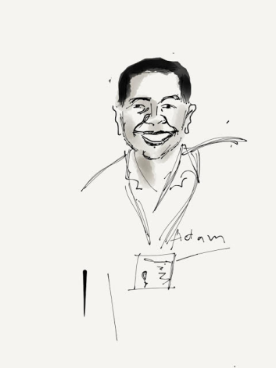

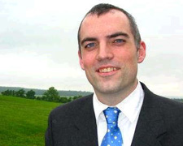

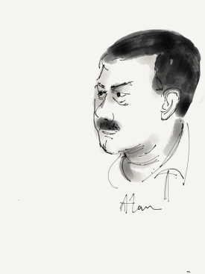

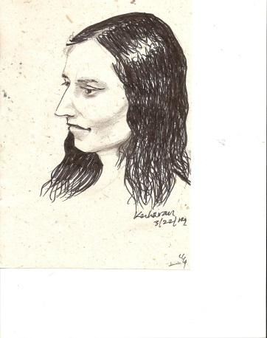
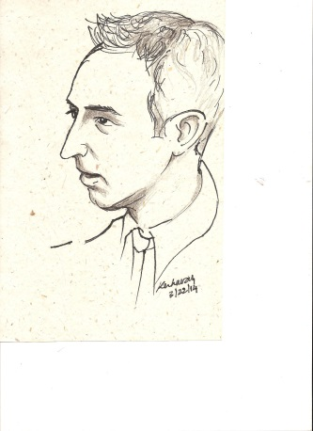
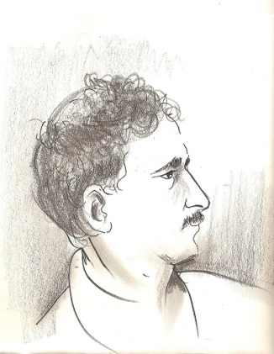
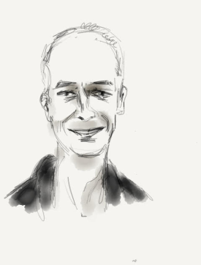
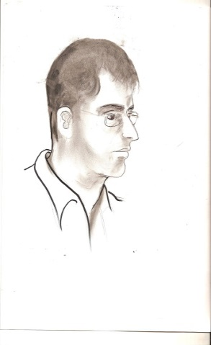
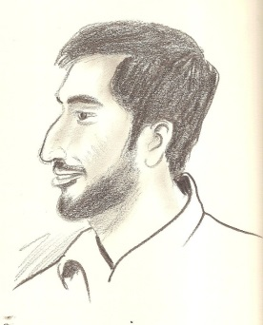
IMPACT: Imaging, Psychopathology, Cognition and Therapeutics
Home | Studies | People | Facilities | Publications | Links | Participate | Contact Us | Directions
Notes:
People

Slide 11
IMPACT: Imaging, Psychopathology, Cognition and Therapeutics
Home | Studies | People | Facilities | Publications | Links | Participate | Contact Us | Directions
The IMPACT Cognitive Enhancement Program. This program seeks to develop and implement state of the art cognitive training approaches for the treatment and prevention of major psychiatric disorders such as schizophrenia. Our approaches include computer based cognitive training, individual and group therapy.
The IMPACT Imaging Laboratory seeks further knowledge about the neurochemical, neurophysiological, and neuroanatomical basis of psychiatric disorders using state of the art brain imaging techniques such as Magnetic Resonance Spectroscopy (MRS), Magnetic Resonance Imaging (MRI), functional MRI (fMRI), and Diffusion Tensor Imaging (DTI). This laboratory also aims to investigate the neurobiological mechanisms of medications and psychosocial treatments of psychiatric disorders, such as schizophrenia, affective and anxiety disorders, as well as co-morbid medical disorders such as diabetes, insulin resistance and metabolic syndrome.
The IMPACT Electrophysiology Laboratory. This laboratory, led by Matcheri Keshavan and Brandon Hager, uses the techniques of system level electrophysiology to study the brain mechanisms of major psychiatric illness. This laboratory has the capability to obtain evoked response studies, eye movement studies, prepulse inhibition studies, and evaluations of gamma oscillations, all of which offer promising biomarkers for neuropsychiatric illness.
Notes:
Facilities

Slide 12
IMPACT: Imaging, Psychopathology, Cognition and Therapeutics
Home | Studies | People | Facilities | Publications | Links | Participate | Contact Us | Directions
1990-1995 | 1996-2000 | 2001-2005 | 2006-2010 | 2011-2015
Click on a time-span above to view publications from those years.
Publications on these Disorders:
Publications on these Techniques:
Psychosis
Bipolar Disorder
Schizophrenia
Depression
Autism
ADHD
22q DS
Structural Imaging
Functional Imaging
MR Spectroscopy
DTI
Sleep
Genetics
EEG/ERP
Notes:
Publications: Click on Links to Open to Another Page with publications from 1990-1995, 1996-2000, 2001-2005, 2006-2010, 2011-2015

Slide 13
IMPACT: Imaging, Psychopathology, Cognition and Therapeutics
Home | Studies | People | Facilities | Publications | Links | Participate | Contact Us | Directions
Links
http://www.bidmc.org/
http://www.cedarclinic.org/
http://www.brighamandwomens.org
http://hms.harvard.edu/hms/home.asp

Slide 14
IMPACT: Imaging, Psychopathology, Cognition and Therapeutics
Home | Studies | People | Facilities | Publications | Links | Participate | Contact Us | Directions
If you are interested in participating in research studies, please click if any one or more of this applies to you:
I have been diagnosed with schizophrenia or schizoaffective or bipolar disorder
I have a close relative or family member with a diagnosis of schizophrenia, bipolar, or schizoaffective disorder
I often have unusual thoughts or feelings that I cannot explain
I have difficulties with memory, attention, or other cognitive functions for which I need help.
I have Type I diabetes
I have been diagnosed with a depressive disorder
If you are interested to volunteer as a student in our program, please indicate:
I am interested in learning about your brain imaging and EEG studies: Contact Nick Bolo PhD or Roscoe Brady MD PhD
I am interested in your Cognitive Remediation Studies: Contact Luis Sandoval PhD or Michelle Friedman-Yakoobian PhD
I am interested in your Biomarker studies: Contact Joanne Wojcik PhD

Slide 15
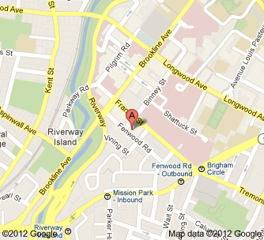
IMPACT: Imaging, Psychopathology, Cognition and Therapeutics
Home | Studies | People | Facilities | Publications | Links | Participate | Contact Us | Directions
Directions:
The Massachusetts Mental Health Center is located in the Longwood Medical Area, at 75 Fenwood Road Boston, MA 02115. For directions to our facility, and easy access through public transportation, see below.
Public Transportation- Green Line: Take the Green Line, E train, get off at the Brigham Circle. Once you are off the T, walk down towards Brigham and Women's Hospital (Francis Street), at the corner of Francis Street and Binney Street turn left and walk down towards Fenwood Road. The Massachusetts Mental Health Center will be on your right.
Bus: Take the 39 bus, which stops at Huntington Avenue and Francis Street. Once you have gotten at Huntington and Francis Street, walk down towards Brigham and Women's Hospital (Francis Street). At the corner of Francis Street and Binney Street turn left and walk down towards Fenwood Road. The Massachusetts Mental Health Center will be on your right. Take the 66 bus, which stops at Tremont Street and Huntington Avenue. Walk down Francis Street towards Brigham and Women's Hospital. At the corner of Francis Street and Binney Street turn left and walk down towards Fenwood Road. The Massachusetts Mental Health Center will be on your right. Both buses 60 and 65 stop at Brookline Avenue and Francis Street. Walk down Francis Street towards Brigham and Women's Hospital. At the corner of Francis Street and Binney Street turn right and walk down towards Fenwood Road. The Massachusetts Mental Health Center will be your right.

